Slide 1

Nasa mission control: day 2
Squad leaders: Evan
Co-captain: Corey
Notes:
Do all of the introductions and round robins here

Slide 2
Mission details
DEADLINE: 4 HOURS
DEBRIEFINGS: INTERMITTENTLY THROUGHOUT THE DAY
POLICIES: NO ENGINEER LEFT BEHIND
MATERIALS: RASPBERRY PI, ELECTRONICS KIT, WITS, AND DETERMINATION
OBJECTIVE: POWER AN LED WITH A BUTTON

Slide 3
Some extra details about python
CONDITIONAL STATEMENTS
THEY CHECK THE TRUTHINESS OF A STATEMENT AND WILL EVALUATE TO TRUE OR FALSE
CODE INSIDE THE BLOCK (TABBED AREA) OF A CONDITIONAL STATEMENT WILL ONLY BE EXECUTED IF THE CONDITION IS SATISFIED
CAN USE IF, ELIF, AND ELSE STATEMENTS FOR CODE EXECUTION
Notes:
SOME ITEMS THAT WERE NOT DISCUSSED THAT COULD BE GENERALLY GOOD TO GO OVER?

Slide 4
SOME MORE DETAILS
WHILE LOOP
RUNS THE BLOCK OF CODE (TABBED SECTION) WHILE THE DESIRED CONDITION IS TRUE
PARAMETERS
THE ARGUMENTS THAT ARE SUPPLIED TO A FUNCTION
EX: print() RECEIVES PARAMETERS FOR WHAT TO DISPLAY IN THE SHELL
THIS IS THE MESSAGE THAT WE INSERT INSIDE OF THE PARENTHESES
Notes:
EXTENDED FROM THE LAST SLIDE

Slide 5
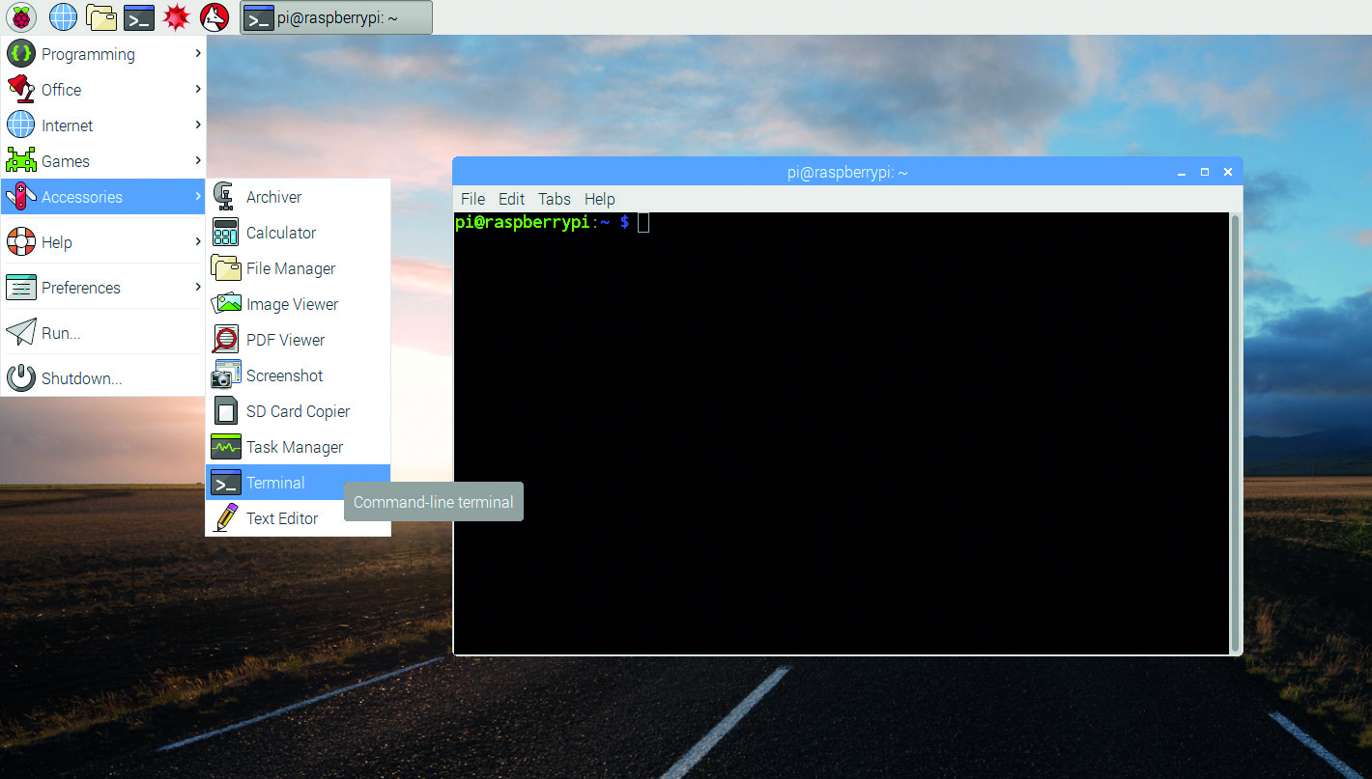
Commanding your pi
OPEN A COMMAND TERMINAL
Ctrl + Alt + T
MAKE YOUR OWN FOLDER
cd /home/pi/Documents
mkdir Week1_AM_YOUR_TEAM
CHECK PYTHON VERSION
python --version
OTHER USEFUL COMMANDS
pwd : PRINTED WORKING DIRECTORY
ls : LIST
man : MANUAL
rmdir : REMOVE DIRECTORY

Slide 6


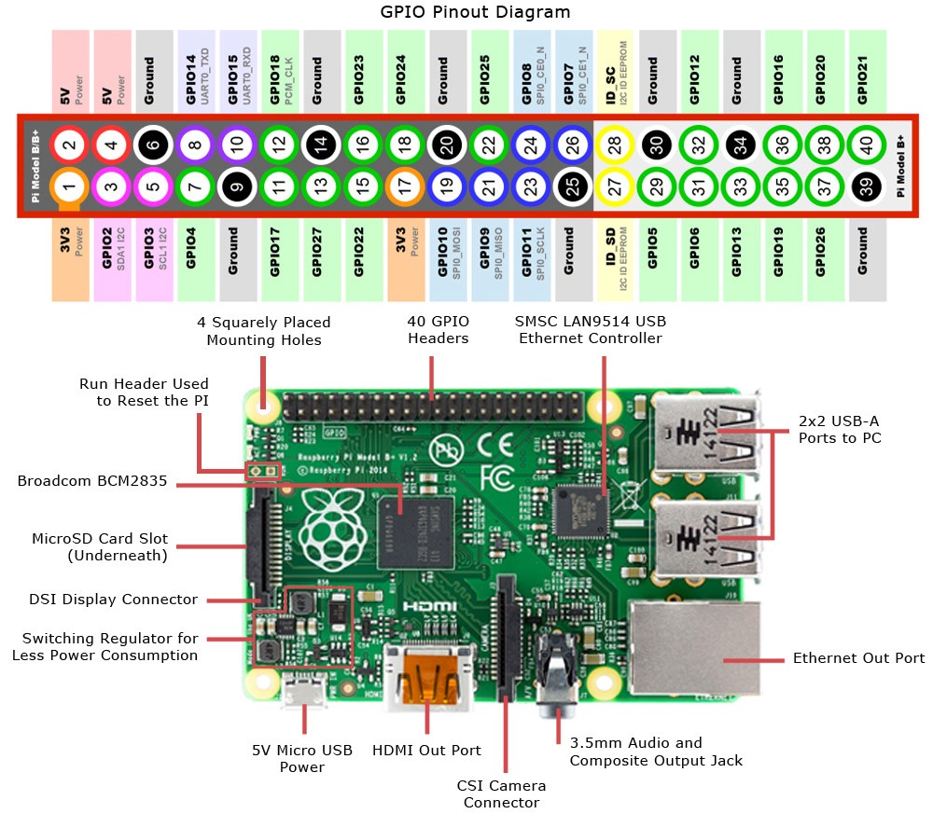
Raspberry pi peripherals

Slide 7

URL: KAHOOT.IT
Notes:
Day 2: Pi Quiz

Slide 8
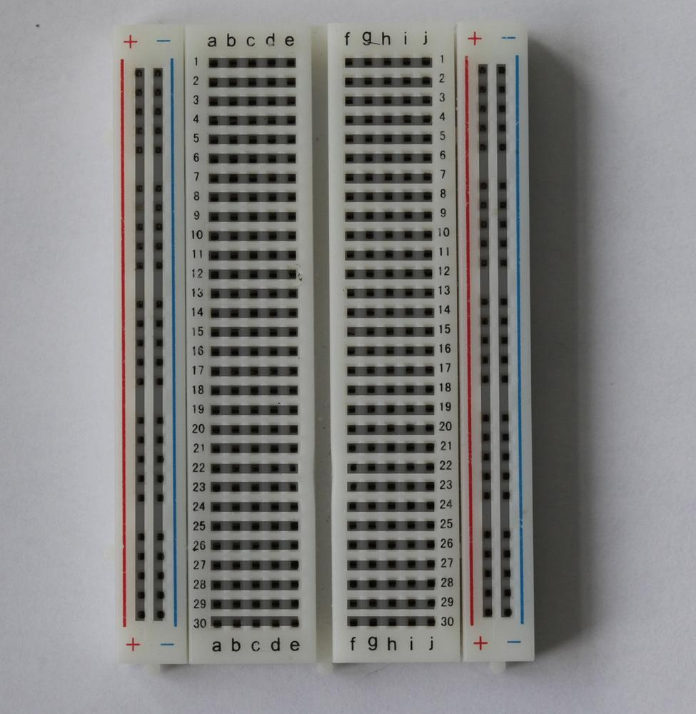
WHAT IS A BREADBOARD?

Slide 9
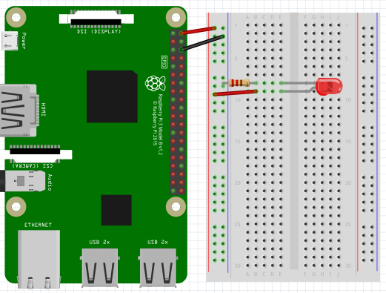
SETTING UP YOUR CIRCUIT
Notes:
Go through the room and help them set up the circuits. A little bit of Ohm’s law if you feel like it. Explain current limiting resistor.

Slide 10
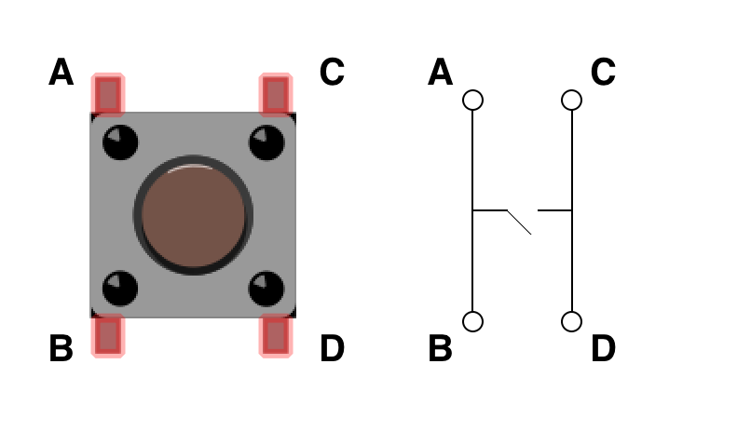
HOW DOES A BUTTON WORK?

Slide 11
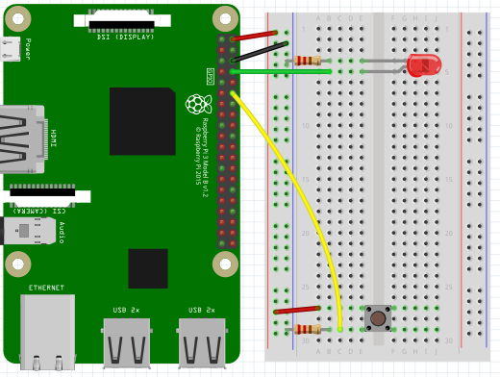
Adding a button

Slide 12
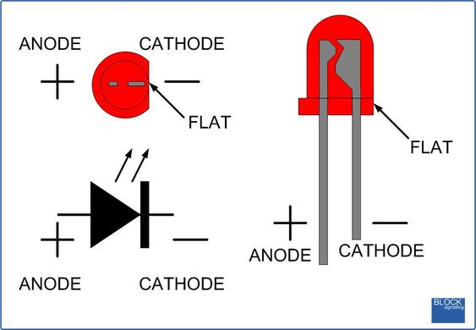

Slide 13
Getting the python file using sftp
WHAT DOES SFTP STAND FOR?
OPEN A COMMAND TERMINAL
sftp MY_PI’S_IP_ADDRESS
“raspberry”
cd /home/pi/Documents
get 1_toggleLED_Shell /home/pi/Documents/Week1_AM_YOUR_TEAM
exit
cd /home/pi/Documents/Week1_AM_YOUR_TEAM
idle 1_toggleLED_Shell

Slide 14
Python libraries
WHAT IS A LIBRARY?
HOW DO WE USE A LIBRARY?
import NAME_OF_LIBRARY as NAME
WHAT DOES THE as DO?
WHAT LIBRARIES ARE NEEDED?
RPi.GPIO

Slide 15
Python setup: WE WILL NEED THESE LINES OF CODE
GETTING THE LIBARY
import RPi.GPIO as GPIO
SETTING LIBRARY TO BROADCOM MODE
GPIO.setmode(GPIO.BCM)
SETTING UP THE PINS
GPIO.setup(PIN_NUMBER, GPIO.OUT)
GPIO.setup(PIN_NUMBER, GPIO.IN)
CHECKING AND WRITING TO THE PINS
GPIO.input(PIN_NUMBER) #input READS whether the pin is HIGH (True) or LOW (False)
GPIO.output(PIN_NUMBER, True/False) #output WRITES the pin HIGH or LOW
Notes:
Have them write the code with the skeleton file, walk around and help them.

Slide 16
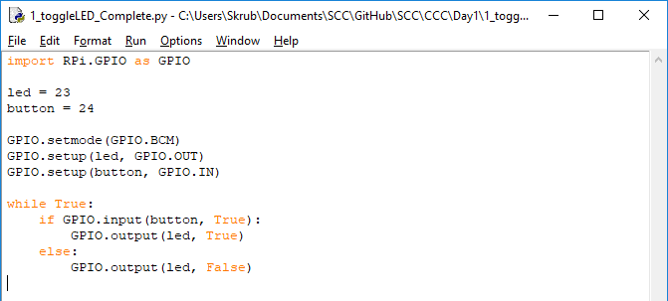
Optimized code
Notes:
Run through the code with them

Slide 17
URL: KAHOOT.IT
Notes:
Day 2: End of day quiz

